Slide 1
BITS ZG553: Real Time Systems L13 – Requirements Engineering for Real Time Systems
K G Krishna
WILP Division, BITS-Pilani, Hyderabad

Slide 2
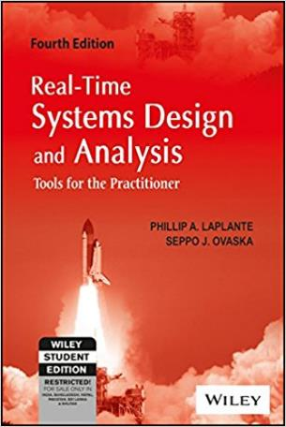
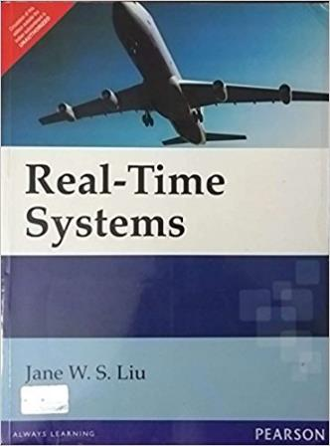
Text Book / References
Reference (R1)
Text Book (T1)
Note: As the above two books focus on theoretical treatment of the subject, Students are strongly advised to refer to web sources / MOOCs videos / library within their own organizations for more practical understanding of the topics.

Slide 3
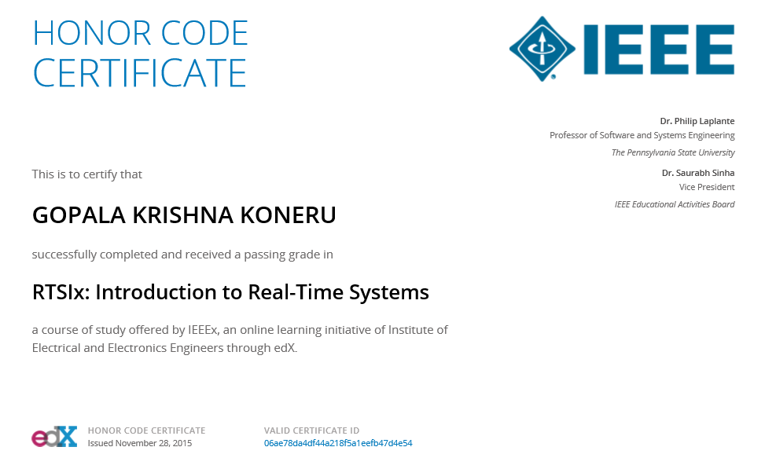
Excellent MOOCs Videos
(Coursera, edX,…)

Slide 4
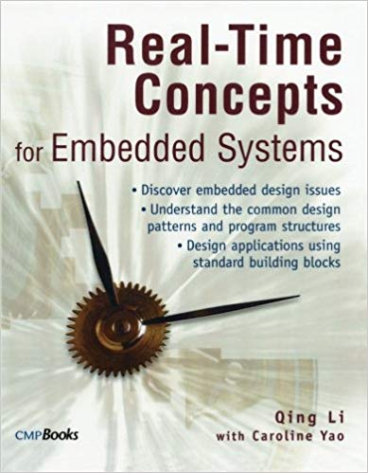
RTS Primer – For Light Reading

Slide 5
L-13: Requirements Engineering for RTS
[Ref: Notes/PPT]
Note: Students are requested to NOT to rely on PPTs/Recorded sessions as their only source of knowledge, explore sources within your own organization or web for any specific topic; attend classes regularly and involve in discussions;
PLEASE DO NOT PRINT PPTs, Save the Environment!
Source PPT Courtesy: Some of the contents of this PPT is sourced from Presentatoons of Prof K R Anupa / Prof B Mishra, BITS-Pilani WILP Division

Slide 6
Introduction
Requirements engineering is the subdiscipline of software engineering
Concerned with determining the goals, functions, and constraints of software systems.
The goal is to create a requirements specification that is complete, correct, and understandable to both customers and developers.
While the development of the solution is considered increasingly as commoditized activities (if requirements are made clear), hence can be outsourced, requirement engineering is a crucial activity and therefore should be conducted by the development organisation – together with an appropriate group of customer representatives.

Slide 7
Requirement Engineering Process
Preliminary Study
Requirements Elicitation
Requirements Definition
Feasibility Report
Domain Model
Requirements Validation
Definition of Requirements
Requirements Document
Requirements Specification
Adapted from Sommerville (2000)

Slide 8
Types of Requirements
As per IEEE, a general software requirement for a real-time software are of following types:
C1. Functional : Fundamental actions of features
C2. External Interfaces: Inputs and Outputs
C3. Performance : Static and Dynamic numerical requirements
C4. Logical database: Logical requirements related to database
C5. Design constraints: Restrictions
C6. Software system attributes: Various quantifiable attributes
Types C2-C6 are categorized under ‘Non-Functional’ Requirements.

Slide 9
Functional Requirements
All system inputs
Exact sequence of operations and responses (outputs) to normal and abnormal situations for every input possibility
May use case-by-case description or other general form of description (e.g. using universal quantification, use cases, user stories)

Slide 10
External Interface Requirements
name of item
description of purpose
source of input or destination of output
valid range, accuracy, and/or tolerance
units of measure
timing
relationships to other inputs/outputs
screen formats/organization
window formats/organization
data formats
command formats

Slide 11
Performance Requirements
Static and dynamic requirements placed on the software or on human interaction with the software as a whole .
Might include:
the number of simultaneous users to be supported
the numbers of transactions and tasks the amount of data to be processed within certain time periods for both normal and peak workload conditions
...
…

Slide 12
Logical database requirements
Types of information used by various functions such as
Frequency of use
Accessing capabilities
Data entities and their relationships
Integrity constraints
Data retention requirements

Slide 13
Design constraint requirements
Related to :
Standards compliance
Hardware limitations

Slide 14
Software system attribute requirements
Reliability
Availability
Security
Maintainability
Portability
Any other miscellaneous requirements you can think of …

Slide 15
Requirements specification for real-time systems- Approaches
There is no one way to do it. Various ways include:
Top-down process decomposition or structured analysis
Object-oriented approaches
Program description languages (PDL) or pseudo-code
High-level functional specifications that are not further decomposed
Ad hoc techniques, including simply natural language and mathematical description, and are always included in virtually every system specification

Slide 16
3 Types of Specification Techniques
Formal: Involve rigorous mathematical or logical modeling
Informal: Can’t be translated into rigorous mathematical notations and associated rules (e.g. specifications involving flowcharts where the decision blocks involve natural languages)
Semiformal: Methods which don’t fall into the above two categories e.g. models involving UML.
Boundaries between these are sometime unclear.

Slide 17
Formal Methods in System Specification
Contribute significantly to requirements formulation and validation by use of extensive mathematical techniques
By nature, real-time systems usually contain some formalism of mathematical expression of interaction with the operating environment.
Three typical use of formal methods
Consistency checking: System behavioral requirements are described using a mathematically-based notation.
Model checking: Uses state machines to verify whether a given property is satisfied under all conditions.
Theorem proving: Axioms of system behavior are used to derive a proof that a system will behave in a given way.

Slide 18
Finite State Machine (FSM)
A finite state machine can be described mathematically by a five tuple, M = { S, i, T, ∑, δ }
S is a finite, non-empty set of states
i is the initial state (i is a member of S),
T is the set of terminal states,
∑ is an alphabet of symbols or events used to mark transitions,
δ is a transition function that describes the next state of the machine given the current state, and a symbol from the alphabet (an event).

Slide 19
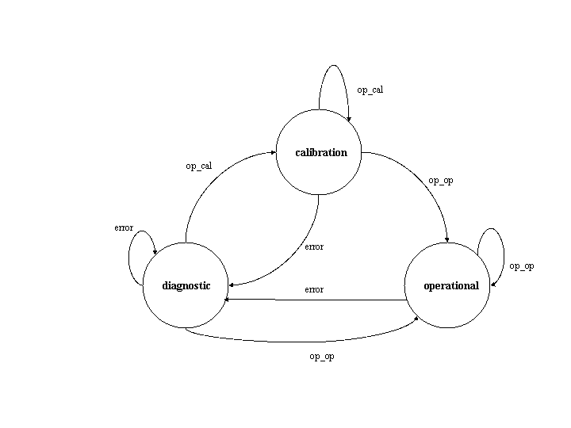
Finite State Machine - Example
S={calibration, diagnostic, operational}, i=calibration, T=S and
∑ = {op_op, op_cal, error}. The transition function δ can be described by a set of triples of the form (state, signal, next_state).
Source: P. A. Laplante, Real-Time Systems Design and Analysis, Wiley, 3rd edition

Slide 20
State Charts
Statechart = FSM + Depth + Orthogonality + Broadcast Communication
FSM is a finite state machine,
Depth represents levels of detail
Orthogonality represents the existence of separate tasks
Broadcast communication is a method for allowing different orthogonal processes to react to the same event.
The statechart resembles a finite state machine where each state can contain its own FSM that describes its behaviour.
Statechart is part of UML.

Slide 21
State Charts
Various components of the statechart:
The FSM is represented in the usual way, with capital letters or descriptive phrases used to label the states.
Depth is represented by the insideness of states.
Broadcast communications are represented by labelled arrows, in the same way as FSMs.
Orthogonality is represented by dashed lines separating states.
Symbols a,b, . . . , z represent events that trigger transitions, in the same way that transitions are represented in FSMs.
Small letters within parentheses represent conditions that must be true for the transitions to occur.

Slide 22
State Chart - Example
Source: P. A. Laplante & S. J. Ovaska, Real-Time Systems Design and Analysis: Tools for the Practitioner, Wiley, 4th edition

Slide 23
Petri Nets
First introduced by Carl Adam Petri in 1962.
A diagrammatic tool to model concurrency and synchronization in distributed systems.
Based on strong mathematical foundation.
Consists of three parts:
Circles: Called Places (means States)
Rectangles: Transitions (or events)
Arcs (Arrows): Connects Places to Transitions
Each Arc is labeled with a number. If there is no label on an arrow, it is considered as ‘1’.
Tokens are represented as black dots, which move from one place to other at each transition.
Change of transition at an event is called firing of event.
Markings (m₀, m₁, …) represents initial data count (represented by tokens) in all the places
At each transition, tokens move from one place to other based on the direction of the arrow.

Slide 24
Petri Nets
Firing Table
 | P₁ | P₂ | P₃ | P₄ | P₅
m₀ | 1 | 1 | 0 | 0 | 0
m₁ | 0 | 0 | 1 | 0 | 0
m₂ | 0 | 0 | 0 | 1 | 1
P₁
P₄
P₃
m₀
P₂
P₅

Slide 25
Petri Nets
P₁
P₄
P₃
m₁
P₂
P₅
P₁
P₄
P₃
m₂
P₂
P₅

Slide 26
Petri Nets – Example – Vending Machine
Simple Vending m/c, accepting Rs 5/- and Rs 10/-.
All snacks are of Rs 5/- or Rs 10/-
Rs 5
Take out
Rs 5 Snack
Add Rs 5
Add Rs 5
Rs 0
Take out
Rs 5 Snack
Take out
Rs 10 Snack
Add Rs 10
Rs 10

Slide 27
Semi-Formal Methods
Two wide-spread approaches:
Structured Analysis and Structured Design (SA/SD)
Closely associated with procedural programming languages like C
Unified Modeling Language (UML)
Closely associated with object oriented programming languages like C++ and Java
UML is covered extensively in the subject like ‘Software for Embedded Systems’, ‘Object Oriented Analysis and Design’ etc.

Slide 28
Structured Analysis and Structured Design (SA/SD)
Three complementary models to describe a real-time system.
M1. Environmental Model
Context Diagram
Event List
Natural Language
M2. Behavioural Model
Data Flow Diagram
Control Flow Diagram
Entity Relationship Diagram
Data Dictionary
Process Specification
Control Specification
State Transition Diagram
Natural Language
M2. Implementation Model
Structure Charts
Pseudocode
Temporal Logic
Natural Language

Slide 29
Structured Analysis and Structured Design (SA/SD)
The purpose of the environmental model is to model the system at high level of abstraction.
Behavioral model embodies the design aspect of SA/SD as a series of data flow diagrams, control flow diagrams, entity-relationship diagrams, process and control specifications, state transition diagrams and data dictionary.
At the lowest level of abstraction, implementation models like pseudocode come into picture.

Slide 30
The Requirement Document
SRS (Software Requirement Specification) can be viewed as a binding contract among the designers, developers, testers and customers.
Recommended table of contents for the SRS as per IEEE Std 830-1998:
1. Introduction
1.1 Purpose
1.2 Scope
1.3 Definitions and Acronyms
1.4 References
1.5 Overview
2. Overall Description
2.1 Product Perspective
2.2 Product Functions
2.3 User Characteristics
2.4 Constraints
2.5 Assumptions and Dependencies
3. Specific Requirements
Appendices
Index

Slide 31
Requirement Validation
The purpose of requirement validation is to ask this question – “Am I building the right software ?”
Requirement Validation involves checking the followings:
Validity - Does the system provide the functions that best support the customer’s needs?
Consistency -Are there any requirements conflicts?
Completeness -Are all functions required by the customer included?
Realism -Can the requirements be implemented given available budget and technology?
Verifiability -Can the requirements be checked?

Slide 32
Requirement Validation
Many ways of checking the software requirements specification for conformance to IEEE standard’s best practices:
Automated consistency analysis
Checking the consistency of a structured requirements description.
Comparing the requirements to those for a similar system
Developing tests for requirements to check testability.
Prototyping.
Requirements reviews.
Systematic manual analysis of the requirements.
Test-case generation.
Using an executable model of the system to check requirements.

Slide 33
Thank You.
Any Questions?

